Slide 1
Sampling-Based Path Planning

Slide 2
Contents
Objective
Problem Statement
Motivation
Rapidly-Exploring Random Tree(RRT)
How does it work?
Conclusion

Slide 3
Objective
The objective is to produce a continuous motion that connects a start configuration S and a goal configuration G, while avoiding collision with known static obstacles using Rapidly-Exploring Random Tree(RRT).
RRT path is then smoothen to reduce number of edges.

Slide 4
Problem
Problem:
Find a path from start point to goal point.
Asked for:
A sequence of control inputs that leads from start to goal.
Why Tricky?
Need to avoid Obstacles

Slide 5
Motivation
Motion planning is a term used in robotics for the process of breaking down a desired movement task into discrete motions.
For example, navigating a mobile robot inside a building to a distant waypoint.
Sampling-Based Path Planning has proven to be an effective framework suitable for a large class of problems in domains such as robotics.
Notes:
It should execute this task while avoiding walls and not falling down stairs. A motion planning algorithm would take a description of these tasks as input, and produce the speed and turning commands sent to the robot's wheels.

Slide 6
Rapidly-Exploring Random Tree
A Rapidly-Exploring Random Tree (RRT) is an algorithm designed to efficiently search nonconvex, high-dimensional spaces by randomly building a space-filling tree.
The key idea is to bias the exploration toward unexplored portions of the space by sampling points in the state space and incrementally pulling the search tree towards them.

Slide 7
Why RRT?
RRTs are faster than the basic probabilistic roadmap approach for holonomic planning problems.
RRT easily handle problems with obstacles and differential constraints (non-holonomic and Kino dynamic)
RRT is probabilistically complete i.e., with probability one. If run for long enough the graph will contain a solution path if one exists.

Slide 8
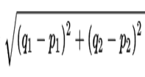
Fixed-Radius nearest neighbors
In mathematics, the Euclidean distance or Euclidean metric is the "ordinary" (i.e., straight-line) distance between two points in Euclidean space.
We assume that we are given a set P of n points in the plane. The Euclidean distance between two points p and q in P, denoted by |pq| is |pq|=
Given the set P and a distance ɛ > 0, our goal is to report all pairs of distinct points p,q ∈ P such that |pq|≤ ɛ. This method is called Fixed-Radius nearest neighbors.

Slide 9
Collision Detection
Collison detection is a key bottleneck in path planning. The RRT algorithm used, checks for collision of each individual node as well as the edge that joins the two nodes.
Collision is detected when the robot position(Individual node) is same as that of obstacle position i.e., they overlap or penetrate.
For detecting the collision of the obstacle and the edge drawn between two points, the points on the edge are spaced equally and each individual node is checked for collision.

Slide 10
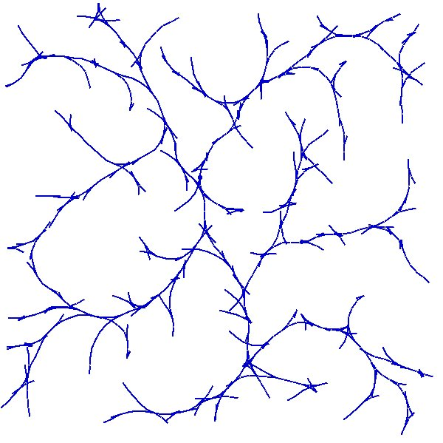
How does it works?
Build a rapidly-exploring random tree in state space (X), starting at start S.
Stop when tree gets sufficiently close to goal G.
Goal
Start
Notes:
As with MOP, the planner works by constructing a tree rooted at the start point. When the tree grows sufficiently close to the goal, the algorithm terminates. Since the tree is a directed graph, the path to the goal can be uniquely determined by following the tree backwards from the goal to the start point.

Slide 11
Building an RRT
To extend an RRT:
Pick a random point a in X
Find b, the node of the tree closest to a
Find control inputs u to steer the robot from b to a
b
u
a
Notes:
Initially, an RRT contains only the start node.
To expand an RRT, we randomly pick a point from the state space. Next, we find the node in the RRT closest to our randomly chosen point, and we compute the control inputs necessary to steer the robot towards the randomly chosen point.

Slide 12
Building an RRT
To extend an RRT:
Pick a random point a in X
Find b, the node of the tree closest to a
Find control inputs u to steer the robot from b to a
b
u
a
Notes:
Initially, an RRT contains only the start node.
To expand an RRT, we randomly pick a point from the state space. Next, we find the node in the RRT closest to our randomly chosen point, and we compute the control inputs necessary to steer the robot towards the randomly chosen point.

Slide 13
Building an RRT
To extend an RRT (cont.)
Apply control inputs u for time δ, so robot reaches c
If no collisions occur in getting from a to c, add c to RRT and record u with new edge
b
u
c
a
Notes:
We integrate the computed control inputs for some small time interval, and arrive at some new position in state space. If the path to this new node can be verified to be collision free, then the new node is added to the tree, along with the control inputs used to reach it.

Slide 14
Executing the Path
Once the RRT reaches G
Backtrack along tree to identify edges that lead from S to G.
Drive robot using control inputs stored along edges in the tree.
Notes:
Because the control inputs are stored with each edge in the tree, once the tree grows sufficiently close to the goal state, we can derive the sequence of control inputs necessary to steer the robot to the goal by following the tree backwards from the goal state to the start state, keeping track of the incremental control inputs stored with each edge we transverse.

Slide 15
Sampling and Building the Tree
The path is planned by building a tree starting from the position of the robot.
While the Search tree has not reached the goal, and haven’t ran out of iterations
Pick an initial node using random sampling.
Find the nearest node in the Search Tree Closest to the random point.
Now it is checked if that point collides with an obstacle in the space.

Slide 16
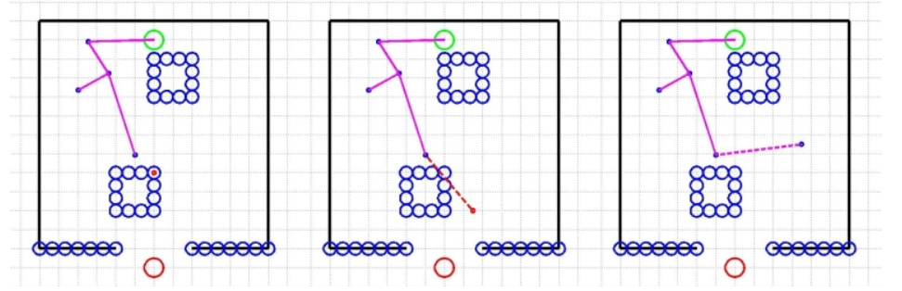
If the sampled point has no collisions, it is then checked if the edge between the sampled point and the nearest existing point in the tree has any collisions.
If this straight line path has no collisions, the sampled point is added to the tree with the nearest point as its parent node. If there is a collision, this point is thrown out.

Slide 17
Each time after a node is added to the tree and than node is less than some known threshold distance from the goal position, it is checked if the goal can be reach in a straight line path from the added node.
If the goal position is reachable without colliding it’s edge with an obstacle, the goal position is added to the tree with the recently added node as its parent. At this point, the path planning is complete.
If the goal position is still unreachable, additional points are sampled.

Slide 18
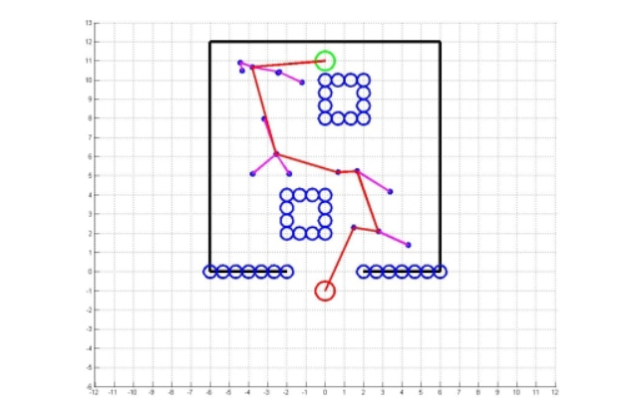
An example of a completed path is shown below.

Slide 19
Limitations
It is necessary to polish the path given by RRT and decrease the number of result edges.
If the path does not exists between two desired points, the program may end up in an infinite iteration loop.

Slide 20
Path Smoothing
Optimal path planning is not suitable for real-time applications. Randomized motion planners tend to find not so great path. Therefore, a phase called path smoothing is required after a possible path is found.
After a path is found, path smoothing can be applied to make a smoother, more direct route to the goal.
This can be done iteratively by sampling points between nodes on the overall path and then checking if two points could be connected to reduce the overall path length.

Slide 21
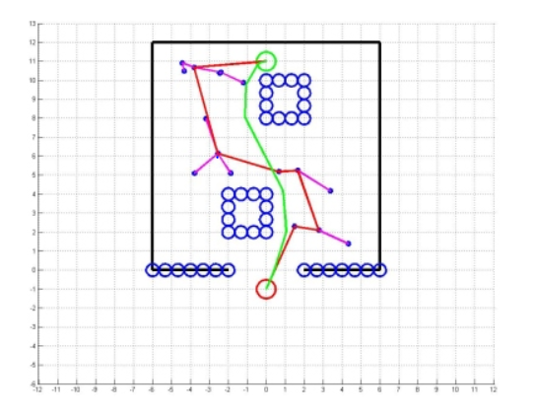
Outcome of Path Smoothing
Example: Along the found path, pick two vertices Xt1, Xt2 and try to connect them directly

Slide 22
OUTPUTS

Slide 23
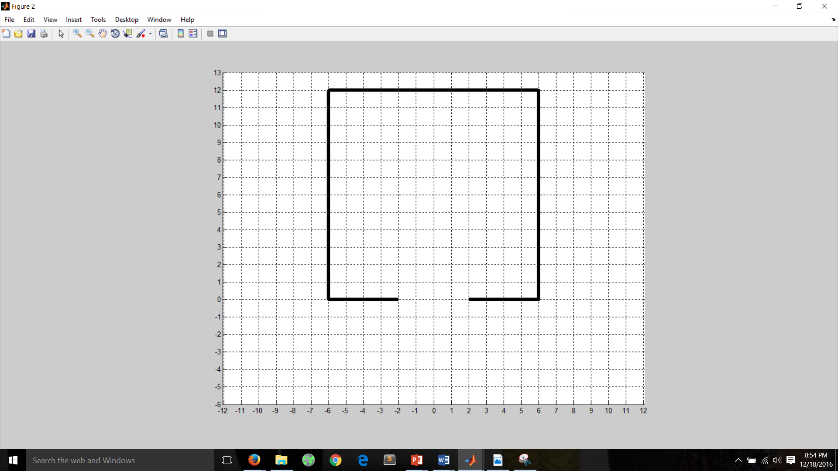
Basic Configuration space (state space)

Slide 24
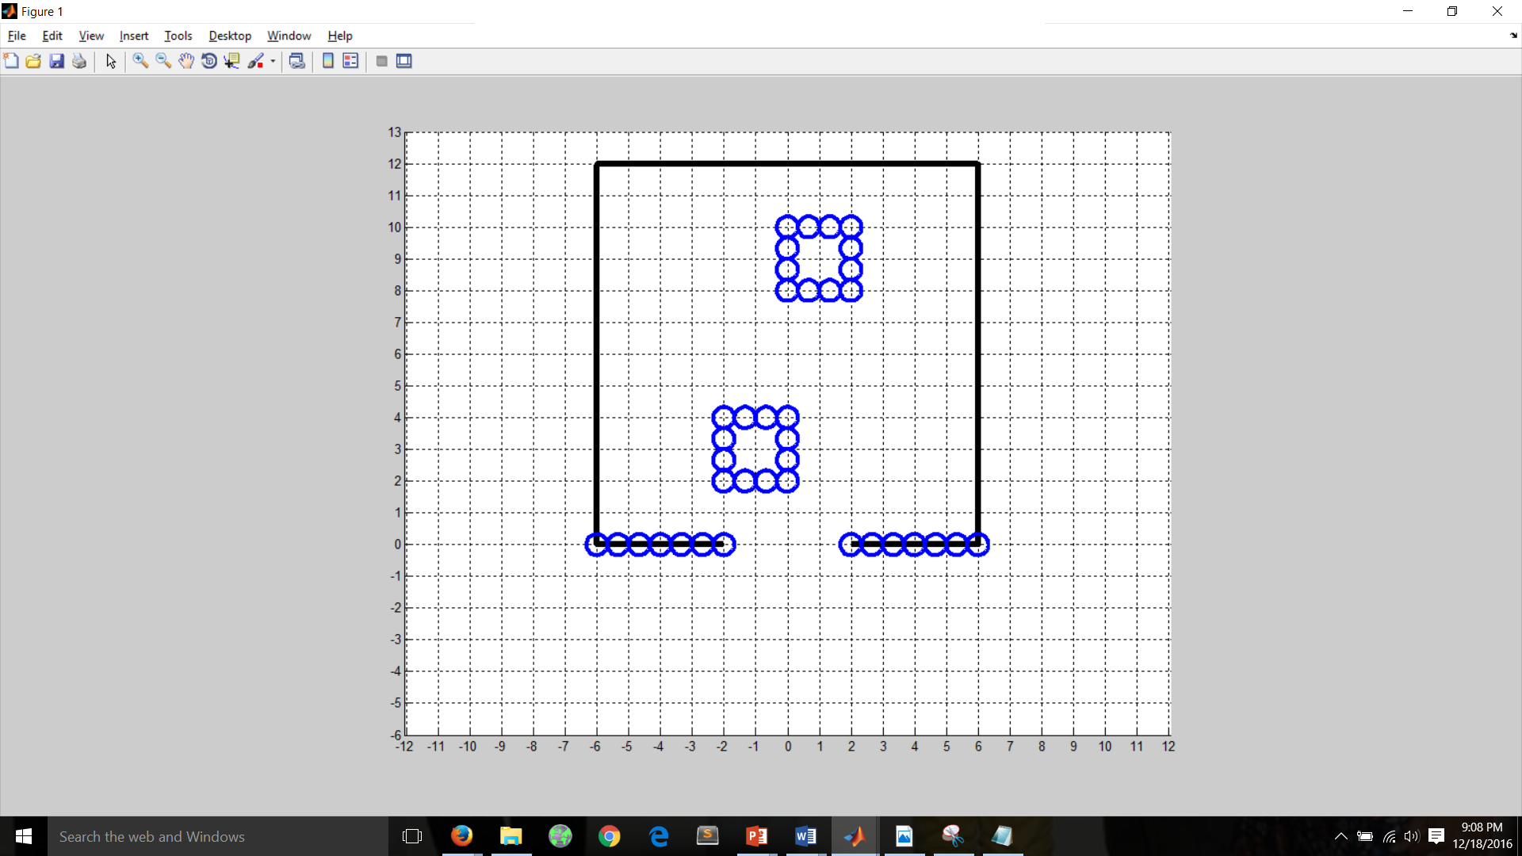
A configuration with a few obstacles in C-Space

Slide 25
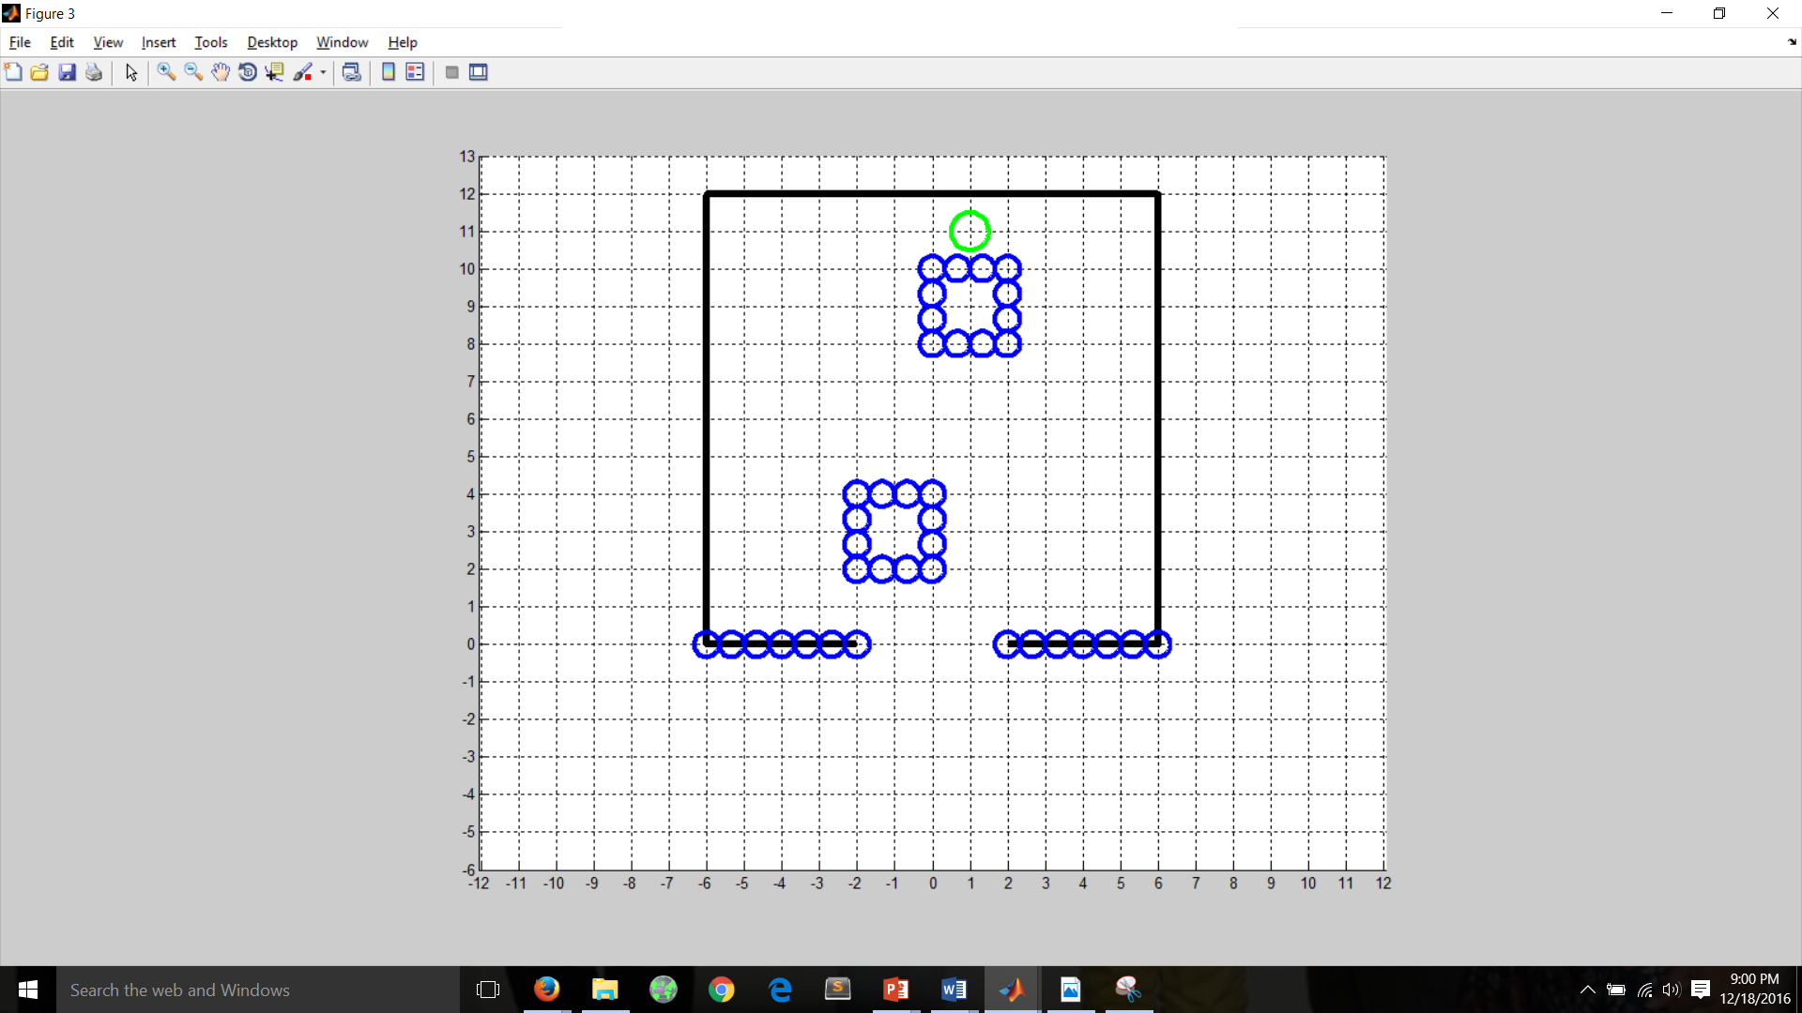
C-space with the Start Point

Slide 26
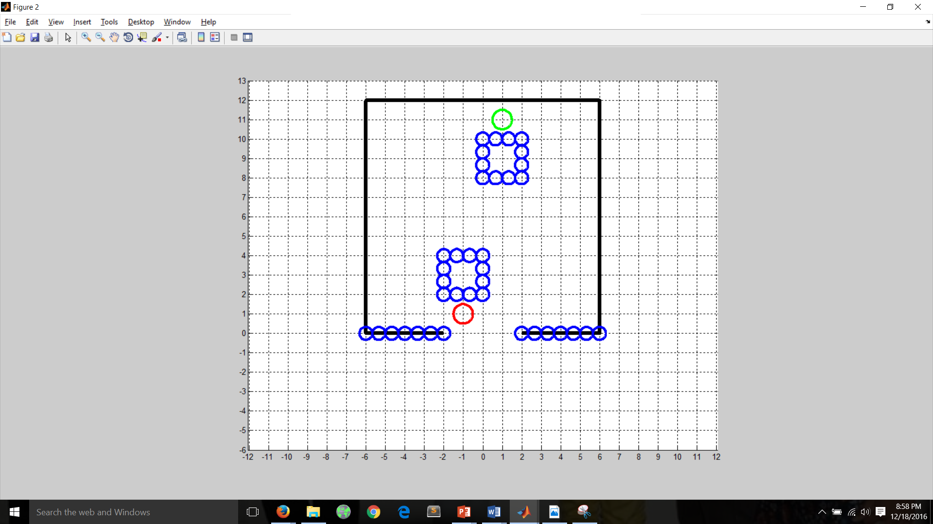
Start Point and Goal Point Set in C-Space

Slide 27
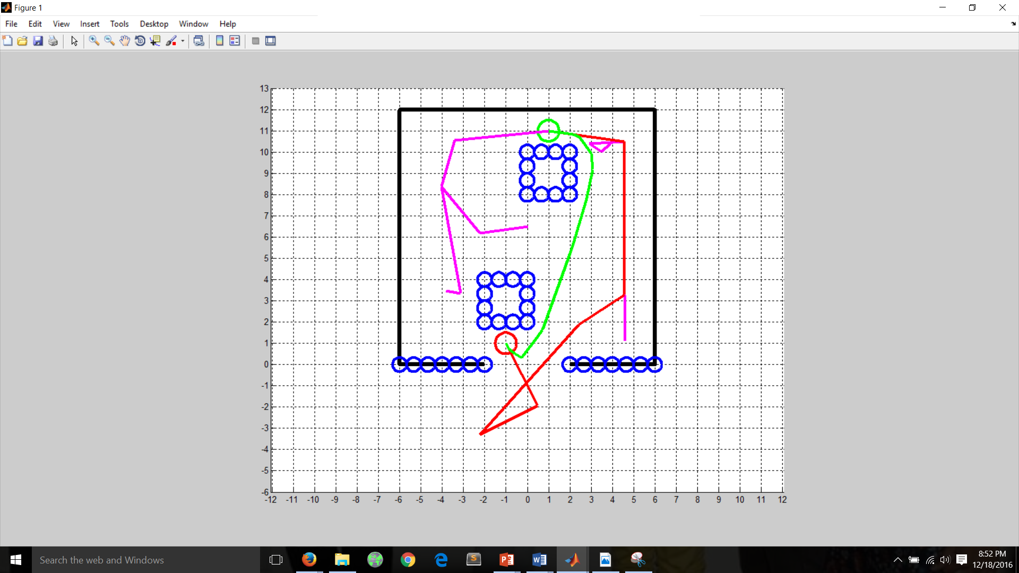
Goal Reached
Red Color path - RRT path
Green Color path - Smoothen Path

Slide 28
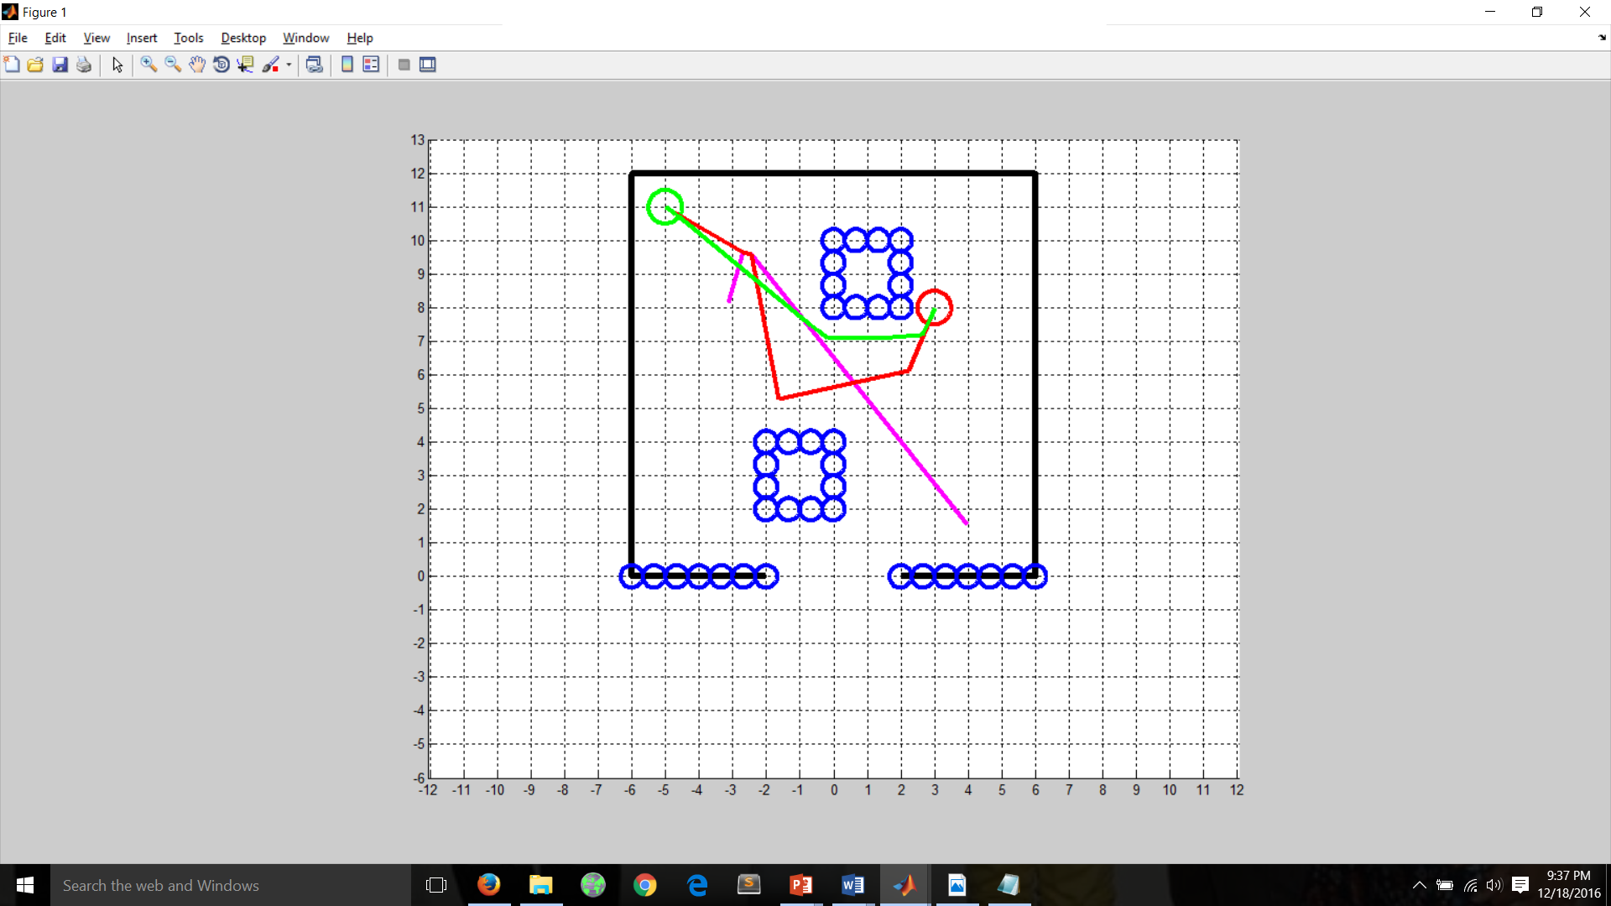
Output 1: Different starting points and goal points.
Red Color path - RRT path
Green Color path - Smoothen Path
Number of iterations-24

Slide 29
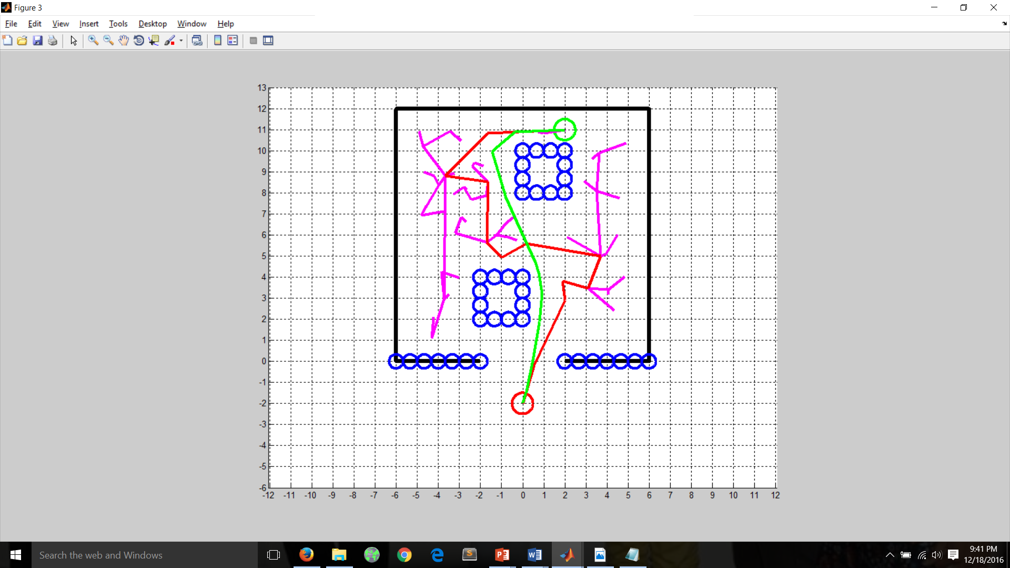
Output 2: Different starting points and goal points.
Red Color path - RRT path
Green Color path - Smoothen Path
Number of iterations-240

Slide 30
Conclusion
RRT is the main weapon of the planner. In order to fit the problems, some modification of the standard RRT algorithm was made here.
RRT works quite well for both holonomic and non-holonomic, although the solutions are not optimal.
Path smoothing is performed to reduce the number of edges produced by RRT tree.
More than 80% of the times the path after smoothing is better than path found by RRT.

Slide 31
THE END
THANK YOU!
Any Questions?

